Slide 1
Sharing Monsanto’s Story:
Food, Inc.

Slide 2
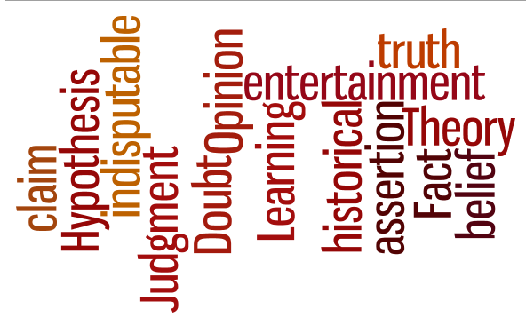
What is a documentary to you?
Notes:
Opinion. A belief or judgment that rests on grounds insufficient to produce complete certainty.
Theory. A hypothesis or belief.
Fact. A thing that is indisputably the case.
Claim. An assertion of the truth of something, typically one that is disputed or in doubt
Before we get started, let us discuss documentaries.
Documentary- The purpose of documentaries varies from film to film. There are as many answers to this question as there are filmmakers!
These films have a variety of goals:
. To create public interest or inform viewers
. To convey opinions
. To record important events or ideas
. Simply to entertain or delight the audience in some way
The information in a documentary (or movie) is presented to us in a different way than the written word and can be more impactful because visually recorded fact is received as irrefutable evidence. We become transformed on an emotional level stemming from our belief system in some way. MORE IMPORTANTLY- this is an interesting supplement to the ways we get information and learn- particularly in the classroom.
How is information taken away from this type of media?
Visual Appeal
Positively influenced to take action
Create public interest or awareness
Promotes new insights
Encourages critical thinking

Slide 3
Food, Inc. attempts to piece together a big picture…
But when the pieces don’t connect, gaps in the information create confusion and mislead the audience
Notes:
Result- an unbalanced conversation:
While the film primarily attacks large multinational agricultural and food corporations, the less than accurate information and assumptions upon which the film is based negatively affect one’s perception of the food system including many modern farming practices. This is a dangerous result in a nation that boasts the gold standard for food safety and efficient food production.
Opinion. A belief or judgment that rests on grounds insufficient to produce complete certainty.
Theory. A hypothesis or belief.
Fact. A thing that is indisputably the case.
Claim. An assertion of the truth of something, typically one that is disputed or in doubt

Slide 4
Let’s fill in the gaps - Topics discussed in Food, Inc. about Monsanto
Seed saving, Patents, and legal agreements
Monopolizing the soybean industry
“Revolving door” with government regulators
Safety of GM crops
Labeling of GM Crops

Slide 5
Food, Inc. Suggests…
Monsanto sues farmers for allegedly saving patented seed OR small amounts of our traits found in farmers’ fields
What are the facts?
Farmers are our customers and priority
Farmers agree to not save and plant patented seed
Farmers can choose to save seed if they buy non-patented seed
We have pledged publicly to never sue (nor have ever sued) a farmer for trace amounts of seed in their field
In saved seed matters, we make every effort to avoid litigation
Notes:
First and foremost, farmers are essential to not only our business success but to the global food security of the future. As a company dedicated to agriculture, Monsanto is committed to the success of farmers. Farmers are our customers, and we work hard to deliver products that meet their needs and expectations.
Details on litigation:
Although they have tended to get a lot of attention, lawsuits between us and farmers who plant seeds without paying for them are actually very rare. Every year, hundreds of thousands of farmers plant our seeds. And since 1997, when we started trying to protect the patents on our seeds, we have gone to trial with a fraction of 1 percent of those customers. When you consider that we sell seed to more than 325,000 American farmers a year, it’s really a small number. . In any case where Monsanto is awarded monies, proceeds are directed from these settlements to youth leadership and scholarship programs
Monsanto has never sued a farmer when trace amounts of our patented seeds or traits were present in the farmer’s field unknowingly or as a result of inadvertent means. Monsanto has a long-standing public commitment that “it has never been, nor will it be, Monsanto’s policy to exercise its patent rights where trace amounts of our patented seeds or traits are present in a farmer’s fields as a result of inadvertent means.”
Other Resource-Monsanto Sues Farmer??- The Truth Revealed! https://www.youtube.com/watch?feature=player_detailpage&v=L5Cd2q8Jf6k
http://www.monsanto.com/food-inc/pages/faqs.aspx#q4
GMOAnswers.com and Monsanto.com/food-inc

Slide 6
Interestingly enough..
The patenting of seeds was first permitted under the Plant Patent Act of 1930-which significantly pre-dates biotech seeds
Patents – whether for new plants or biotech traits – allow the creator of the technology the opportunity to commercialize their innovation and to obtain a return on their investment of time and money for a limited time
GM seeds are not the only type of seeds that can be patented. In fact, many more non-GM plant varieties have been patented than genetically modified ones
Notes:
Patents have been around for hundreds of years, and they exist to drive innovation by encouraging people to invest in creating new things. In agriculture and many other sectors, patents play a valuable role as they contribute to our economy and society as a whole.
A patent allows its owner a certain time- limited measure of control over how others may make, use or sell the patented invention. Many people associate patents with mechanical or electronic devices, new chemical substances, intricate machines or other inanimate things. The notion that patents are also available for living things may be puzzling at first; but the patenting of living organisms dates back to at least 1873
The ability to secure some intellectual property protection with respect to plant-related inventions is common in most developed countries: a number of examples throughout history on “protecting” valuable plants, animals, microbes, etc. from competitors: (1)ancient Chinese empire imposed capital punishment on anyone who smuggled silk moth eggs out of the country. (2) In the middle ages, brewers swore their apprentices to secrecy and fiercely guarded “their” special yeast.
In many cases involving living materials (e.g. genetically engineered bacteria) the inventor even deposits samples in public cell culture banks where they can be accessed by scientists.
Biologically engineered organisms like pest-resistant crops, or modified bacteria for producing antibiotics, are very expensive and time-consuming to develop. A company’s considerable investment in research and development results in innovations that provide important benefits both to farmers and to the people who eat the food they grow. Those benefits include producing more food with fewer resources, which is critical to keeping food affordable as the world’s population grows. Patents encourage continued investment into new and better products.
Patented varieties are NOT unique to Monsanto. There is a long history of patents for new varieties of plants (PVP). For example, some apple varieties found in supermarkets, like Fuji, Red Delicious or Honeycrisp, were patented by the horticultural companies that developed them.
Patents are time-limited and public. Patents generally last either 17 years from issuance (if filed before 1995) or 20 years from filing (if filed after 1995). Exact expiration of any technology depends on the date of filing; The US Patent Office tracks the number of US patents issued to companies per year and The US Patent Office keeps a database of patents by listed owner. Anyone can search this database.
We pursue saved seed matters for 3 main reasons:
Most of our customers stick to their agreements, but some do not. Those few have an unfair advantage over other farmers, because everyone else is paying for seeds that they are saving illegally
No business in any industry can survive without being paid for its products – this is true for agriculture just like it is for medicine, computer software, environmental science, etc
While it’s important to Monsanto to protect our investment, it is extremely important to the entire agricultural community that we continue to reinvest in new and better seed technology
References: https://gmoanswers.com/ask/should-uspto-allow-patenting-living-organisms; https://gmoanswers.com/ask/you-claim-gmo-foods-are-essentially-same-non-gmo-and-therefore-safe-without-proof-other-han; d https://gmoanswers.com/ask/how-does-it-compute-biotech-companies-have-patents-their-ge-crop-varieties-unique-and-different

Slide 7
Topics discussed in Food, Inc. about Monsanto
Seed saving, Patents, and legal agreements
Monopolizing the soybean industry
“Revolving door” with government regulators
Safety of GM crops
Labeling of GM Crops

Slide 8
Food, Inc. Suggests…
Monsanto is the only company that sells biotech seeds and therefore has corporate control over these farmers
What are the facts?
There are hundreds of seed companies in the US that sell to farmers including biotech
Farmers have a lot of seed choices (organic, non-GMO, GMO); they make a new choice EACH year
Our Farmers sign the Monsanto Technology Agreement as part of Stewardship requirements
Notes:
Authorities approved the commercialization of biotechnology applied to soybean seeds in 1996, and many farmers waited to purchase the technology until they saw how it performed the first few years.
Farmers are businesspeople who choose seeds that will provide them with the best yield and highest profit. The Roundup Ready soybean technology delivered excellent results and proved to be extremely popular with farmers. As a result, thousands of farmers decided it was in their best financial interest to make the switch from conventional soybean seeds to Roundup Ready soybean seeds.
By making the technology available through other seed businesses, farmers can access the technology from a multitude of other companies.
Our seed brands would be roughly 1/3 of the U.S. market for corn and soybean seed, There is one other company with a similar or larger share in corn, and our market share is second in soybeans as well. In fact, there are literally hundreds of other seed companies who sell soybean seed to American farmers. More than 1,000 separate seed companies supply the commercial seed market globally. While Monsanto is one of the largest commercial seed companies, what we offer is less than five percent of the world's seeds. www.gmoanswers.com- sara miller
Conclusion: Therefore, if a farmer wants to plant seed from someone other than Monsanto, it’s pretty easy to do that.
What are Farmer’s other seed options?
Organic
Advocates for organic farming claim consumer demand for organics is on the rise, and there is some reliable data to support that claim
Conventional
Farmers can purchase seed from over 200 different seed companies, many of which sell both conventional and biotech seed
Biotech
Farmers who want the benefits of biotech seed, but want to purchase their seed from a company other than Monsanto, have that option as well
Monsanto Technology/Stewardship Agreement (MTSA) http://www.monsanto.com/sitecollectiondocuments/technology-use-guide.pdf
Using seed containing Monsanto technologies solely for planting a single commercial crop.
• Complying with any additional stewardship requirements, such as grain or feed use agreements, produce marketing requirements or geographical planting restrictions, that Monsanto deems appropriate or necessary to implement for proper stewardship or regulatory
Reading and following the directions for use on all product labels.
• Observing regional planting restrictions mandated by the EPA.
http://www.monsanto.com/food-inc/pages/faqs.aspx#q4
GMOAnswers.com and Monsanto.com/food-inc

Slide 9
From a Farmer’s Perspective on the Monsanto Technology Agreement http://bit.ly/1Ss4PdV Here, Brian links to a copy of the agreement AND breaks it down section by section
In a Nut Shell:
”I don’t see anything in there that hurts my farm.”
Notes:
From a farmer’s perspective on the Monsanto Technology Agreement.
Every year, most farmers make the decision to buy new seeds for one of two reasons:
They decide to take advantage of the benefits of new hybrids seeds, or
They choose the benefits of biotech seeds and have signed an agreement that they will not save and either sell or replant the seeds produced from the biotech seeds they bought from their chosen seed vendor.

Slide 10
Interestingly enough..
Although figures in the media claim that Monsanto accounts for more than 90% of the seed sold in corn, soybeans and cotton- this is misleading:
In 2013, Monsanto branded soy and corn seeds account for roughly one-third of the market. Our share is significantly less in other seed crops
Globally, while Monsanto is one of the largest commercial seed companies, what we offer is less than five percent of the world's seeds
However, Monsanto does license some of our technology to others
Notes:
The industry has matured, others are developing or have begun to offer GM traits, so whether Monsanto will be able to keep up those share figures will depend on whether our products perform better and deliver better value than the competitors’ traits.

Slide 11
Topics discussed in Food, Inc. about Monsanto
Seed saving, Patents, and legal agreements
Monopolizing the soybean industry
“Revolving door” with government regulators
Safety of GM crops
Labeling of GM Crops

Slide 12
Food Inc Suggests…
Former Monsanto employees now working in government positions have influenced government decisions on biotechnology
Both the public and private sectors benefit when employers have access to the most competent and experienced people
In every business sector, experienced and highly talented individuals are likely to change jobs to better match and expand their experience, skills and interests
This is similar to superintendants being former teachers; it makes a lot of sense as they know how the classroom functions and will make effective decisions from that experience
Federal laws carefully prevent conflict-of-interest situations when private sector employees take government jobs
What are the facts?
Notes:
One objection opponents of biotechnology have raised is the fact that some former government employees have gone to work for Monsanto, and some former Monsanto employees now have jobs in the public sector. Some critics say this shows conspiracy by Monsanto and the government. Such theories ignore the simple truth that people regularly change jobs to find positions that match their experience, skills and interests.
Instead of the conclusion that these are experienced and highly skilled individuals, critics will suggest it is instead a quite complicated, global governmental conspiracy.
It is likely that someone in government who has concluded biotechnology is a positive, beneficial technology might go to work for a biotech company, just as someone who believes otherwise might find employment in an organization which rejects agricultural biotechnology.
However, the numbers of countries, not to mention farmers, who have embraced GM crops, suggest that it’s not undue influence, but instead useful technology and sound science that have been the deciding factors.
http://www.monsanto.com/newsviews/pages/revolving-door.aspx

Slide 13
Interestingly enough..
The film uses Supreme Court Justice Clarence Thomas as a high profile example but:
Thomas worked at Monsanto as an attorney 12 years before his role as a Supreme Court justice; at that time, Monsanto was not involved in biotechnology
The case in question involved a competitor of ours – Pioneer. It was not a Monsanto case
Even though Thomas wrote the majority opinion in a biotechnology case in 2001, five independent justices voted with him (it was a 6-2 decision)

Slide 14
Interestingly enough..Part 2
Although there are large gaps on each of these issues, the greatest divide among scientists and consumers is whether GMOs are safe to eat.
88% of AAAS scientists say it is generally safe to eat genetically modified (GM) foods compared with 37% of the general public who say the same, a gap of 51 percentage points. Pew Research Center
Notes:
According to Pew Research Center- “Citizens and scientists often see science-related topics issues through different sets of eyes…The largest differences are found in beliefs about the safety of eating genetically modified foods. Fully 88% of AAAS scientists, American Association for the Advancement of Science — our country’s most prestigious independent science group, say it is generally safe to eat genetically modified (GM) foods compared with 37% of the general public who say the same, a gap of 51 percentage points.”
In each of these categories- the public opinion on whether childhood vaccines should be required is 68%; climate change is mostly due to human activity is 50% and consumers in favor of animals used in research is 47%. AAAS scientists polled at 98% consensus that Humans evolve over time, yet only 66% of the consumers polled believe that scientists generally agree on this and 67% of the consumers polled believe that scientists DO NOT have a clear understanding of the health effects of GM crops.
There exists a scientific consensus on GMOs, as well as Climate Change, Vaccinations, Evolution, Animal testing, etc.
Scientific Consensus is NOT bought by Corporations
There is strong scientific consensus that GM Crops are as safe as conventional crops
1st point- this is a tactic unfortunately used to create mistrust among the public and science-based technologies by sending the message that there is not a scientific consensus on GMOs AND that this consensus can be bought.
2nd point- There is a loud minority and even a small group of “scientists” provide the appearance of balance.

Slide 15
Topics discussed in Food, Inc. about Monsanto
Seed saving, Patents, and legal agreements
Monopolizing the soybean industry
“Revolving door” with government regulators
Safety of GM crops
Labeling of GM Crops

Slide 16
Food, Inc. Suggests…
Profit is valued over the safety of GM products
What are the facts?
GM crops are the most widely researched and tested food products on the market
Every GM crop is extensively tested for food safety before they are allowed to be commercialized, these requirements are set forth by all Global Regulatory systems
GM crops are tested in ways conventional and organic crops are not
On average, it takes 13 yrs and costs $130M to develop and test a GM crop before it is commercialized
Notes:
According to the film’s original website trailer: “Our nation’s food supply is now controlled by a handful of corporations that often put profit ahead of consumer health, the livelihood of the American farmer, and the safety of workers and our own environment.”
Biotech crops and their food products have been used worldwide for about 19 years, since the first commercial planting in 1996. Since then, more than three trillion meals (croplife.org) containing ingredients from biotech crops have been safely consumed.
In addition to the EPA, USDA and FDA, regulatory agencies in more than 25 different countries (as of 2016) have independently assessed these products and concluded they are safe for human consumption and the environment.
Due to the rigorous Regulatory processes and safety testing, Biotech crop safety is Overwhelmingly endorsed by:
Health Authorities- WHO, American Medical Assoc, Health Canada, British Medical Association
Scientific Experts- American Association for the Advancement of Science, European Academies Science Advisory Council, National Academies of Science of MANY countries
Government Organizations around the globe- European Commission, Food Standards Australia New Zealand, French Food Safety Agency, Philippines Food and Drug Administration
1000+ Peer-Reviewed Studies over the past 30 years (and still continue)/ 20+ yrs of biotech in the food supply/ over 3 Trillion means and snacks consumed containing biotech ingredients and “0” Food safety or health issues. (National Academies of Sciences Report – 2015)
AND if this isn’t enough, 100 Billion animals have eaten GMOs for over 18 years and guess what happened? Nothing, no unusual trends in health, no impact on animal health (source: A.L. Van Eenennaam and A.E. Young, 2014. Journal of Animal Science - published a comprehensive study using 29 years of livestock productivity and health data from before and after the introduction of GE animal feed).

Slide 17
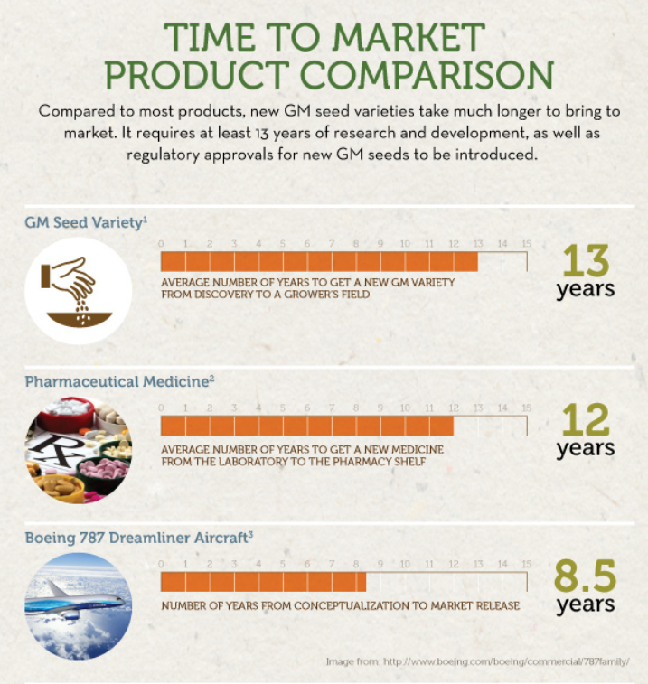
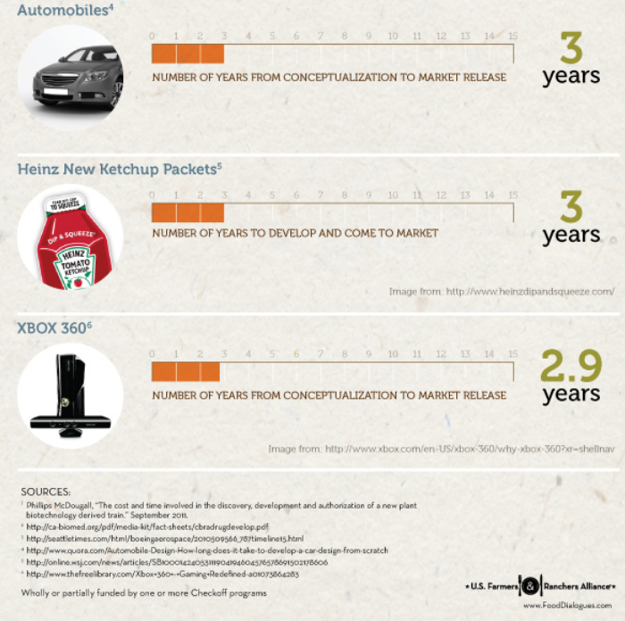
Source: http://esa.un.org/unpd/wpp/
Source: US Third National Climate Assessment (2013)
Source: UN FAO Food Balance Sheet, World Health Organization “Global and regional food consumption patterns and trends”
Source: The World Bank, Food and Agriculture Organization of the United Nations (FAO-STAT), Monsanto Internal Calculations
Source: ISAAA.org
Source: Croplife.org
Notes:
To illustrate that GM crops are more rigorously tested/researched, here is an infographic from the US Farmers and Ranchers Alliance depicting several other products and the avg # of years it takes to get to market.

Slide 18
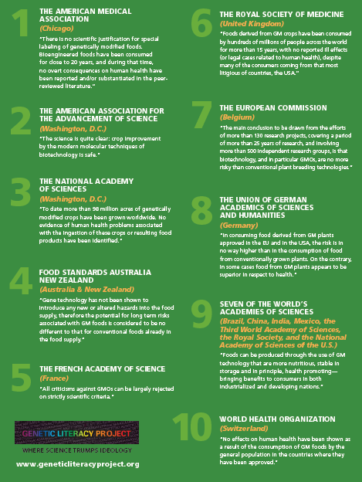
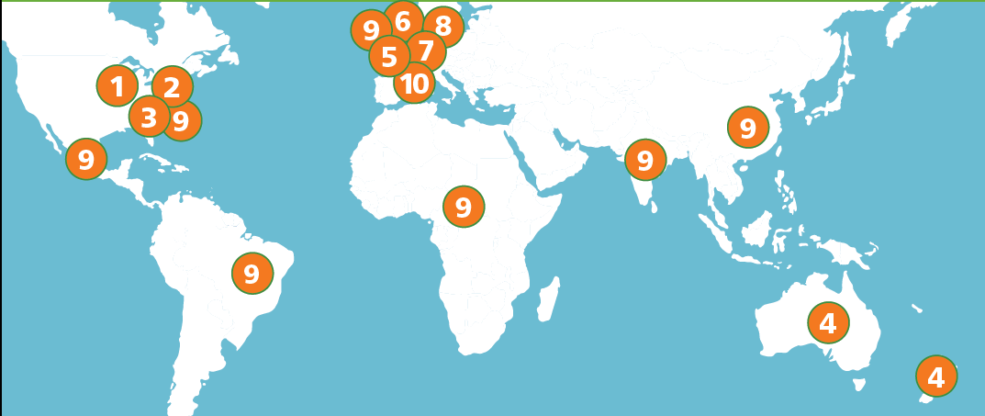
Consensus on Safety by International Science and Health Organizations
Notes:
Food from GM crops has a thoroughly tested, spotless record for safety.
No food on the planet has been more thoroughly researched, tested and regulated.
Independent scientists at regulatory agencies worldwide review the data for each potential product and make their own scientific assessment of its food, feed and environmental safety. There is broad global agreement among food scientists, toxicology experts and regulatory food safety officials on how to evaluate the safety of GM foods; and this strong regulatory framework has successfully ensured the safety of GM seeds.
1-3 years of bioinformatics testing on the DNA and protein sequences
4-6 years of trials (1000’s of plants) to select the one plant with the exact right change
2-3 years of additional analysis
More than 90 agencies globally review, evaluate and approve biotech products for cultivation, import, sale, food/feed uses and since 1996, biotech crops have been grown or imported in by 70 countires.
This whole process takes on average 13+ years and ~$130 million dollars!

Slide 19
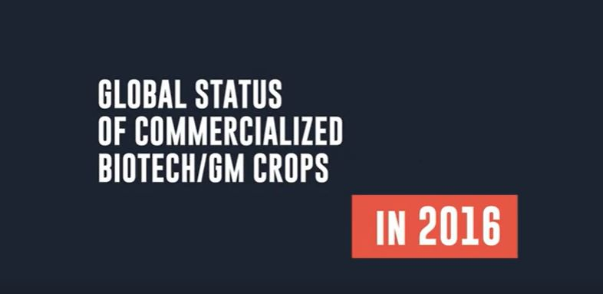
To play video:
click on picture in Slide Show mode
Source: http://esa.un.org/unpd/wpp/
Source: US Third National Climate Assessment (2013)
Source: UN FAO Food Balance Sheet, World Health Organization “Global and regional food consumption patterns and trends”
Source: The World Bank, Food and Agriculture Organization of the United Nations (FAO-STAT), Monsanto Internal Calculations
Source: ISAAA.org
Notes:
In Fact….here is a video that highlights the global cultivation, use and benefits of using Biotech crops from the 2016 ISAAA report (ISAAA.org).
Find it here on YouTube: https://www.youtube.com/watch?v=x9bS50miDIE

Slide 20
Topics discussed in Food, Inc. about Monsanto
Seed saving, Patents, and legal agreements
Monopolizing the soybean industry
“Revolving door” with government regulators
Safety of GM crops
Labeling of GM Crops

Slide 21
Food, Inc. Suggests…
The food industry influences product labeling laws to protect their earnings
Our food labeling laws in the US are regulated by the FDA and food companies adhere to these strict requirements
The biotech industry supports volunteer labeling such as Certified USDA Organic label and GMO Project
We cannot support a label that conveys to consumers that food made from farmers’ crops grown using GMO seeds are less safe, nutritious or different from conventional or organic food
A patchwork of different state labeling laws will cause an increase in the cost of food to the consumer
If any food, including GM food, presented a safety risk—for example, those allergic to a food ingredient—we most certainly would support a mandatory label on that food alerting consumers to this concern
What are the facts?
Notes:
By adding “may contain GMOs”, etc will not provide any useful information to the consumer about nutrition or other dietary health facts. These labels are intended to disparage food made with GMO ingredients and would harm local businesses.
As written, these laws would allow only for an ambiguous “may contain” label, a callout that would serve as a warning to consumers about perceived safety and health risks where there are none.
Other inconsistencies under these proposed laws: what is labeled in a grocery store will not have to be labeled if a restaurant used that same product, and they wouldn’t have to let you know whether or not the dish you ordered contains GMOs. Exceptions would be state by state as each law proposed have mandated different requirements- but these might include gum, meat, alcohol, and cheese. And under Vermont’s current labeling requirements, a can of Spaghetti O’s would require a label but Spaghetti O’s with meatballs would not be labeled.
Additionally, these proposed laws include clauses increase the cost of food due to the need to reformulate products and segregate supply chains for specific states. Source: https://gmoanswers.com/ask/why-are-there-so-many-food-companies-against-gmo-labeling-and-willing-pay-out-millions-and

Slide 22
BUT WAIT! Food, Inc. and Monsanto do share values…
Everyone should have access to safe, nutritious and affordable food. We have families, too
We should know where our food comes from
Each farmer is now able to feed more people than before- which is necessary in our growing population
Farmers are smart business people and care about their land, crops and animals!
Notes:
Although it appears we are here to tell you all that was missing or incorrectly portrayed in the film, there were some very important messages that we can agree on…
This goes back to a balanced conversation!

Slide 23
Our Planet Faces Some Real Challenges
Why is this conversation important to you?

Slide 24
2X Food Demand by 2050
in a more challenging production environment
Source: US Third National Climate Assessment (2013)
Notes:
Everyone should have access to a balanced meal​
Experts agree that we will need to grow as much food in the next 50 years as we did in the past 10,000 years combined if we are to sustain our planet’s population.
We need to double food production by 2050….and the need to grow food in a sustainable manner starts with a rapidly growing global population ​
There are 61 percent more people on the planet today than there were in 1980​!
The United Nations predicts another 35 percent growth in population between now and 2050​
​
Animal-based protein is a much larger portion of the global diet today than it was a few decades ago​. This growing demand requires grain to feed the animals that produce it​
Worldwide, the dietary percentage of protein in 1965 was 9%​…In 2030, it’s expected to reach 14%​ . (Source: UN FAO Food Balance Sheet, World Health Organization “Global and regional food consumption patterns and trends”).​
In order to sustainably grow enough food for our growing world, we need to continue to find ways to help farmers use land more efficiently. ​
We can’t simply create more farmland at the expense of natural habitat​
We must grow enough food from the same amount of land.​
In 1960 there was one acre of farmland per person​; In 2050 the amount of farmland per person will be less than 1/3 of an acre​…this is scary!
It’s clear we need to continue to work together and develop new tools to help farmers use their land as efficiently as possible​ (SOURCE: The World Bank, Food and Agriculture Organization of the United Nations (FAO-STAT), Monsanto Internal Calculations)​
Creating solutions to overcome the challenges posed by a changing climate requires collaboration and a broad range of expertise – and we’re doing our part.​
We apply our knowledge through several practices today, like:​
Traditional plant breeding​
Biotechnology​
Crop Protection​
Precision Agriculture​
​
As the population grows, we will need more schools, homes, etc and in developed countries this includes stores, restaurants, businesses, etc. Cutting down rain forest is not an option, so we look to our broad range of solutions as tools to accomplish feeding the planet safe and nutritious food.
Changing Economies and Diets
A growing global middle class is choosing animal protein – meat, eggs, and dairy – as a larger part of their diet
Animal-based protein is a much larger portion of the global diet today than it was a few decades ago, and this growing demand requires grain to feed the animals that produce it.
Worldwide, the dietary percentage of protein in 1965 was 9%. In 2030, it’s expected to reach 14%. (Source: UN FAO Food Balance Sheet, World Health Organization “Global and regional food consumption patterns and trends”).
Changing Climate
Our changing climate has created a more volatile environment for farming, including increased drought, insect populations and new and renewed disease threats, among others.
Climate change is allowing farmers to grow crops in areas where they’ve not historically been grown. We need to study these changes and apply our knowledge to enable more food production.

Slide 25
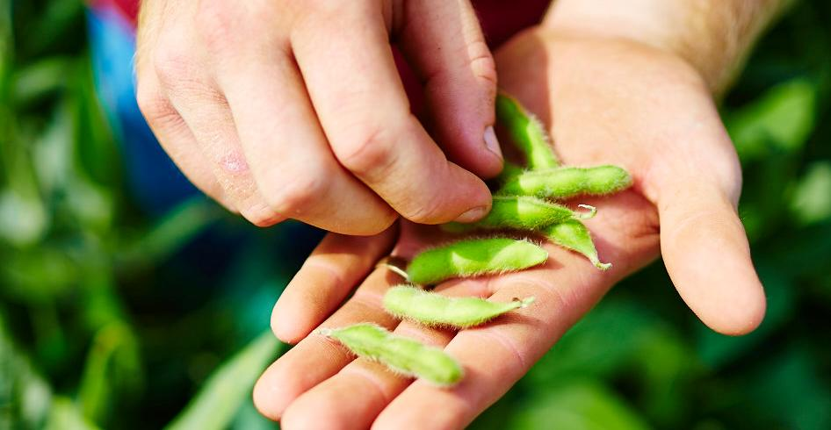
We can meet with needs of the future, using these innovations
Breeding
• Stress Tolerance
• Disease Control
• Yield Potential
Biologicals
• Weed Control
• Insect Control
• Virus Control
Crop Protection
• Weed Control
• Insect Control
• Disease Control
Biotechnology
• Weed Control
• Insect Control
• Stress Tolerance
• Yield Potential • Nutrients
Precision Agriculture
• Precision Planting/ FieldScripts
• Increased production
• Efficient water use
• Efficient nutrient use
Notes:
We are working to leverage all of the tools in the toolbox to meet our mission of producing safe and affordable food.
Our products today include benefits from breeding, biotechnology and crop protection advances. These areas are not independent … they work together to maximize efficiency, effectiveness and sustainability.
There are lots of exciting new areas and ideas in agriculture and there’s a real opportunity to combine these innovations to make a big difference. And as we build out these platforms, we continue to find new ways for each of these areas of innovation to work together to multiply their effectiveness.
Breeding has been ongoing since the dawn of agriculture. As our understanding of the genome has evolved, we’ve improved our efficiency and accuracy in breeding.​
Most plant species have benefited greatly from agricultural breeding, and a good number of the fruits, vegetables and grains we enjoy today did not exist in their current state prior to selective breeding. ​

Slide 26
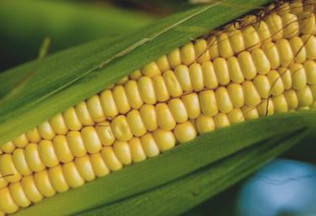
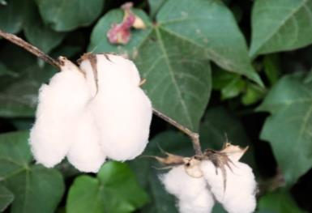
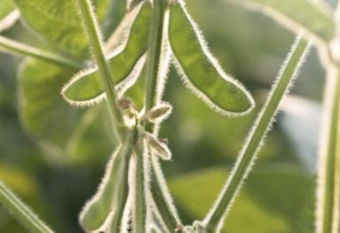
Consumer Benefits- Increased Crop Production
Between 1996 and 2015, Crop Biotechnology was responsible for an additional:
25.2M
Metric Tons of Cotton Lint
357.7M
Metric Tons of Corn
180.3M
Metric Tons of Soybeans
Notes:
Biotechnology has enabled us to dramatically increase production of food and fiber since their introduction in 1996. We’re realizing production of hundreds of metric tons beyond what would be possible with conventional crops. This increase of production helps to reduce the cost of clothing and make a balanced meal more accessible.
It’s important to note that these gains are being realized by farmers small and large.
*Please note, these values change annually as the ISAAA report and PGEconomics report is released.

Slide 27
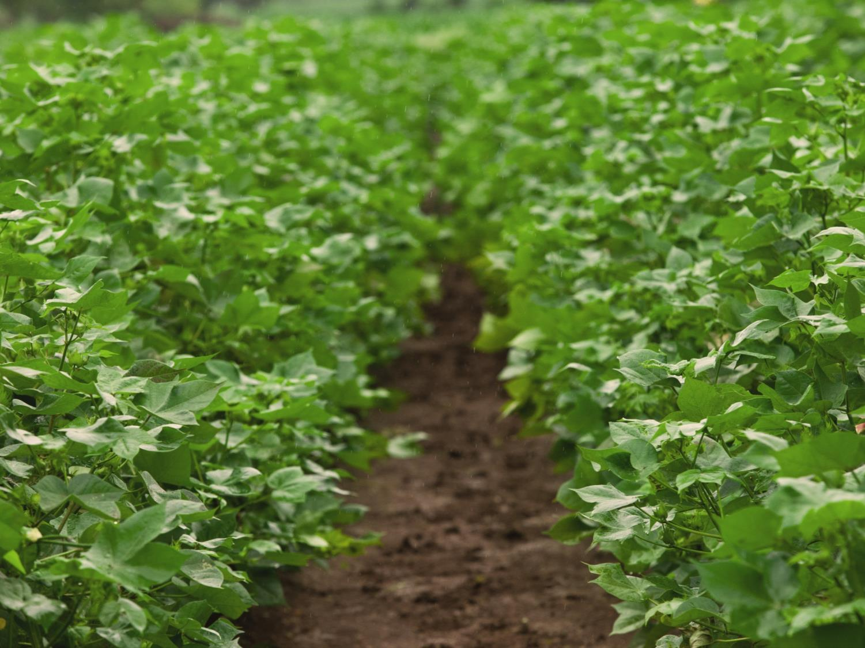
Economic Benefits
Economic gains of ~US$168 billion were generated globally by biotech crops between 1996 to 2015.
Biotech crops in developing countries has already made a significant contribution to the income of >16.5 million smallholder resource-poor farmers in 2015.
30%
Due to reduced production costs
70%
Due to substantial yield gains of 634 million tons
Source: ISAAA.org
Notes:
The economic benefits of GMOs are powerful, with almost $168 billion generated by increased production and efficiency enabled by GMO innovations.
It’s important again to note that GMOs benefit all farmers. The vast majority of farmers who plant GMO seeds are small farmers in the developing world, and they are seeing important benefits in production and efficiency. It’s a common misperception that GMOs and “big agriculture” go hand in hand. In fact, GMOs are equal-opportunity advances. Farmers of all sizes are realizing these benefits.

Slide 28
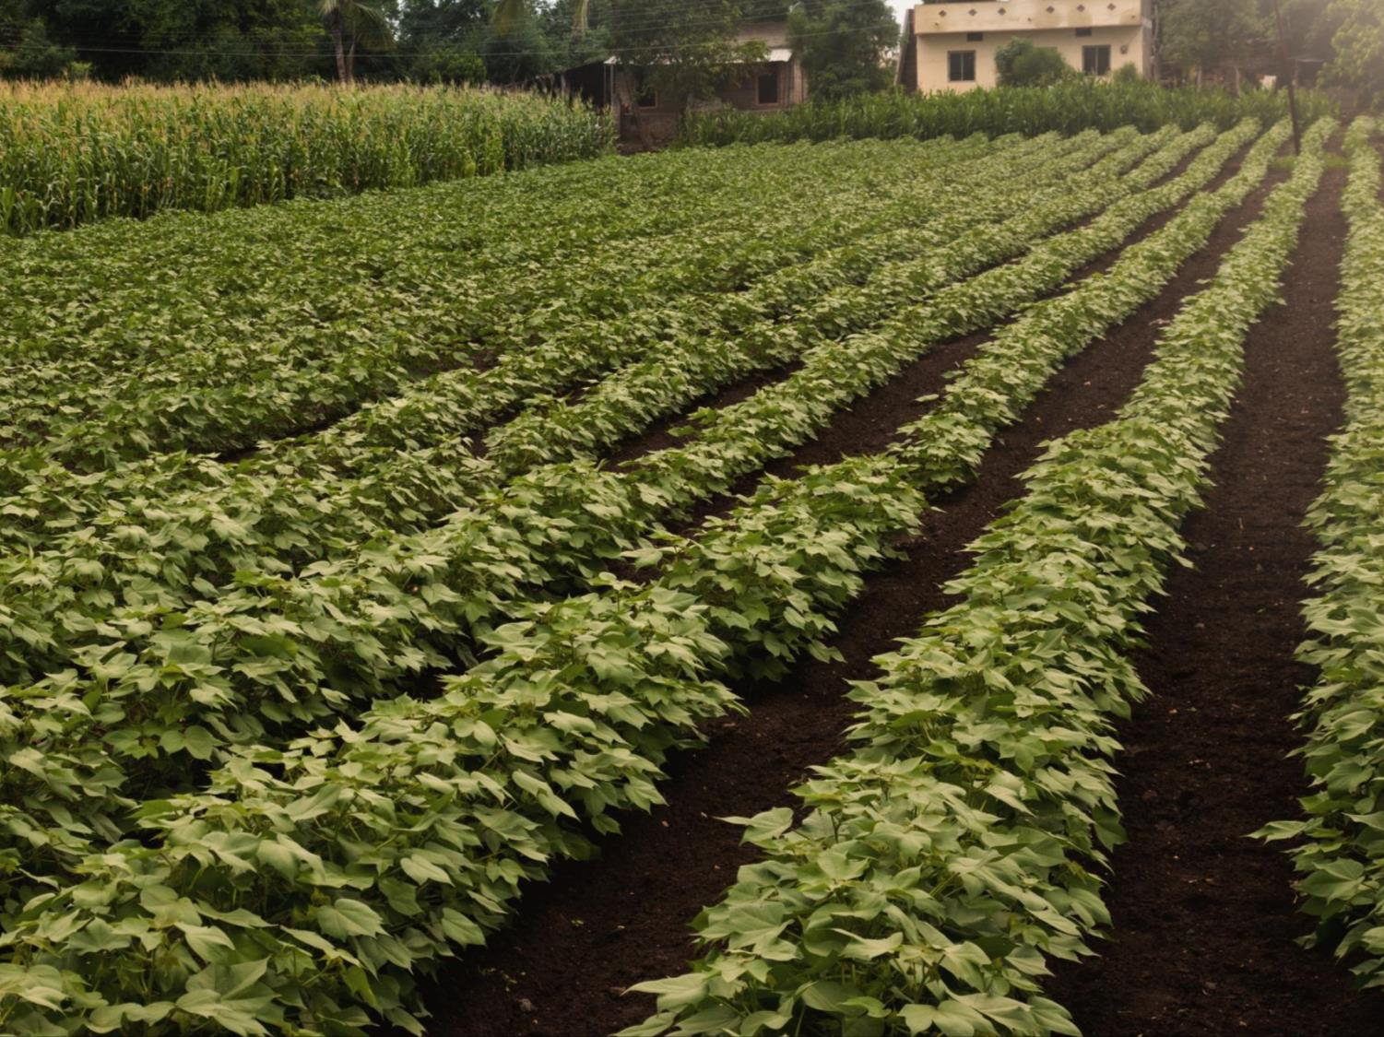
Environmental Benefits
The reduction in pesticides from 1996 to 2015 was estimated at 619 million kilograms or 8.1% reduction
In 2015 alone, biotech helped prevent an estimated 26.7 billion kg of CO₂ emissions, equivalent to removing 11.9 million cars from the road for a year.
Without biotech, it would take an additional 48.1 million acres to produce the same amount of food produced in 2015.
Source: ISAAA.org;
pgeconomics.co.uk
Notes:
The environmental benefits of biotechnology are notable:
The environmental benefits of biotechnology are notable. Through biotech traits, we’ve seen substantial reduction in use of pesticides, more specifically this reduction is equal to the total amount of pesticide active ingredient applied to arable crops in the EU 28 for two crop years. As a result, the reduction in pesticides from 1996 to 2014 was estimated at 619 million kilograms .
We’ve seen reduced CO₂ emissions from farm operations, to the equivalent of removing more than ~12 million cars from the road for an entire year. And we’ve been able to produce more food from less land, preserving more of our natural habitat around the world.
Without biotech, it would take an additional 48.1 million acres to produce the same amount of food produced in 2015.
*Please note, these values change annually as the ISAAA report and PGEconomics report is released.

Slide 29
Thank You
Notes:
I really appreciate the opportunity to provide this background to you today. With the volume of evidence that we’ve seen regarding GMO safety and benefits, it’s fair to ask how we ended up with so many questions and concerns over the past few years.
There are a variety of reasons for that. One of them is that Monsanto and others who are focused on innovation in agriculture didn’t do as good of a job as we needed to in explaining what we were doing. We’re working hard to fix that, to provide more information and answer questions from consumers. This talk is an important part of those efforts.
I encourage you to visit GMO Answers, an industry resource that provides more detailed information on GMO benefits and safety. You can allow follow Monsanto on a variety of social media platforms. Feel free to join this important discussion!

Slide 30
Back up Slides

Slide 31
Interestingly enough..Part 2
We pursue saved seed matters for 3 main reasons:
Most of our customers stick to their agreements, but some do not. Those few have an unfair advantage over other farmers, because everyone else is paying for seeds that they are saving illegally
No business in any industry can survive without being paid for its products – this is true for agriculture just like it is for medicine, computer software, environmental science, etc
While it’s important to Monsanto to protect our investment, it is extremely important to the entire agricultural community that we continue to reinvest in new and better seed technology

Slide 32
The Maurice (Moe) Parr case
Case where legal action was finally taken as a last resort
After years of efforts to manage the problem in other ways, Monsanto sought resolution from the court
Monsanto in good faith agreed to forego the financial judgment as long as he honors the terms of the court order
Parr received clear communication about the patent law around Roundup Ready soybeans and knowingly disregarded this information
Notes:
Some other facts about the case:
Mr. Parr had historically received clear communication about the patent law around Roundup Ready soybeans and knowingly disregarded this information by confusing farmers about the law regarding patents.
Affidavits from local farmers allege Mr. Parr misled customers into breaking patent law by convincing them to save patented seed so he could clean their patented seed and profit from that activity.
The injunction also makes clear Mr. Parr will honor the terms of the agreement and stop cleaning patented seeds.
His seed cleaning business was not affected and his business is able to continue to clean conventional soybeans, wheat and other seed.
http://www.monsanto.com/food-inc/pages/seed-saving-and-legal-activities.aspx
http://www.monsanto.com/food-inc/pages/faqs.aspx#q4
http://www.monsanto.com/newsviews/pages/moe-parr.aspx

Slide 33
Case of farmer Troy Roush
Roush comment: Patented seeds has pitted farmer against farmer
Monsanto Response: Seed patents are not the cause of farmers’ disputes but rather, an unfair playing field created by those who choose to ignore the law and their agreements
Case centered on patent infringement
Although Roush is a harsh critic, he is still a customer of Monsanto
Comment: Patent infringement has been a contentious issue in some communities where it has occurred
Monsanto Response: it is often other farmers that make companies aware of saved seed cases
Notes:
Presenter preference- should this be a back up slide?
Some other facts about the case:
Unfortunately, Monsanto cannot speak on the case involving Troy Roush. Monsanto and the Roushes concluded their litigation in 2002 with a confidential settlement agreement. Both parties mutually agreed as part of the settlement that they would not disclose the terms of the settlement or discuss the litigation.
Mr. Roush has made comments that fall outside of the scope of the lawsuit which we can address:
the introduction of patented seeds have pitted farmer against farmer and torn apart rural communities
Patent infringement has been a contentious issue in some communities where it has occurred
Monsanto is frequently made aware of saved seed cases by other farmers who contact our customer service line with this information. They do so because they feel it is unfair that they are being put at a competitive disadvantage by their neighbors who do not follow the law and legal agreements as they do.
http://www.monsanto.com/food-inc/pages/seed-saving-and-legal-activities.aspx

Slide 34
Case of farmer Dave Runyon
Case where Monsanto had reason to believe seeds were being illegally saved
Mr. Runyon was approached regarding our concerns, and he indicated he used only conventional soybeans
It was clear Mr. Runyon did not want to do business with Monsanto, so the business relationship was ended- no litigation
Monsanto would happily reconsider our business relationship if Mr. Runyon works to address the concerns about the prior circumstances
Notes:
Presenter preference- should this be a back up slide?
http://www.monsanto.com/food-inc/pages/seed-saving-and-legal-activities.aspx

Slide 35
Case of Anonymous farmer
During an anonymous interview in the film, a farmer declared this was due to a “gag” order
True- Monsanto will not discuss specifics of seed patent infringement cases if so directed by court order or settlement agreement
False- Monsanto requires these confidentiality or “gag” orders
True- Monsanto only requires confidentiality regarding how settlement payments are structured
True- Due to the fact these accommodations have been portrayed as “gag orders” required by Monsanto, we no longer accommodate such requests except under exceptional circumstances
Notes:
Presenter preference- should this be a back up slide?
http://www.monsanto.com/food-inc/pages/seed-saving-and-legal-activities.aspx

Slide 36
Interestingly enough..Part 2
Often the Tobacco Industry is used as an example of corporate interests influencing government decisions:
Scientific Consensus is NOT bought by Corporations
The scientific consensus NEVER supported the safety of cigarette smoking
There is strong scientific consensus that GM Crops are as safe as conventional crops
Notes:
1st point- this is a tactic unfortunately used to create mistrust among the public and science-based technologies by sending the message that there is not a scientific consensus on GMOs AND that this consensus can be bought.
2nd point- instead of denying the science, the cigarette industry managed an excellent PR marketing portfolio and began encouraging scientific skepticism….Seems eerily similar to the Organic Industry in this way. Anti-GMO campaigns use highly effective advertising content to create skepticism in the public that these products, or the technology doesn’t even have a scientific consensus- so how can we know these are safe. This is not true however.
3rd point- There is a loud minority and even a small group of “scientists” provide the appearance of balance.
Sources: https://docs.google.com/document/d/1GcO5iXcFuuN7AsJoheStj40I20PFY1ID_R8tfgglfz8/edit?pli=1; http://www.crediblehulk.org/index.php/2015/05/14/blowing-smoke-annihilating-the-fallacious-comparison-of-modern-biotech-scientists-to-tobacco-company-lobbyists/

Slide 37
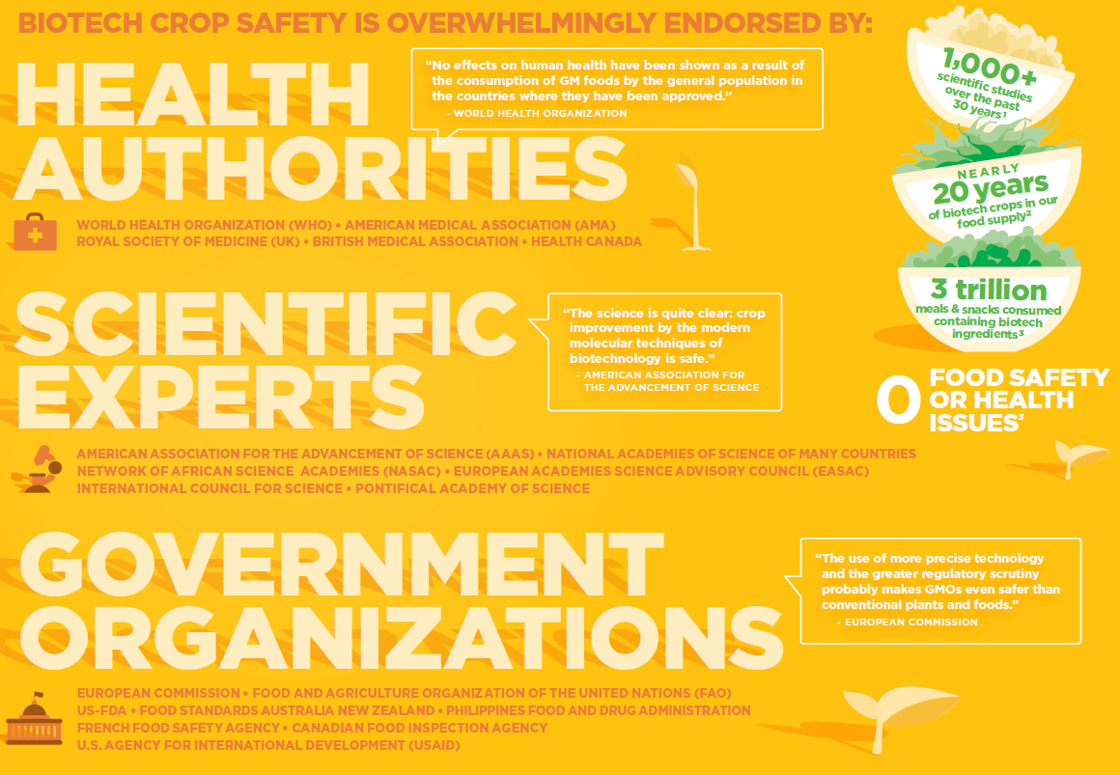
Source: http://esa.un.org/unpd/wpp/
Source: US Third National Climate Assessment (2013)
Source: UN FAO Food Balance Sheet, World Health Organization “Global and regional food consumption patterns and trends”
Source: The World Bank, Food and Agriculture Organization of the United Nations (FAO-STAT), Monsanto Internal Calculations
Source: ISAAA.org
Source: Croplife.org
Notes:
Due to the rigorous Regulatory processes and safety testing, Biotech crop safety is Overwhelmingly endorsed by:
Health Authorities- WHO, American Medical Assoc, Health Canada, British Medical Association
Scientific Experts- American Association for the Advancement of Science, European Academies Science Advisory Council, National Academies of Science of MANY countries
Government Organizations around the globe- European Commission, Food Standards Australia New Zealand, French Food Safety Agency, Philippines Food and Drug Administration
1000+ Peer-Reviewed Studies over the past 30 years (and still continue)/ Nearly 20 yrs of biotech in the food supply/ over 3 Trillion means and snacks consumed containing biotech ingredients and “0” Food safety or health issues.
AND if this isn’t enough, add to this that 100 Billion animals have eaten GMOs for over 18 years and guess what happened? Nothing, no unusual trends in health, no impact on animal health (source: Alison Van Eenennaam published a comprehensive study using 29 years of livestock productivity and health data from before and after the introduction of GE animal feed).

Slide 38
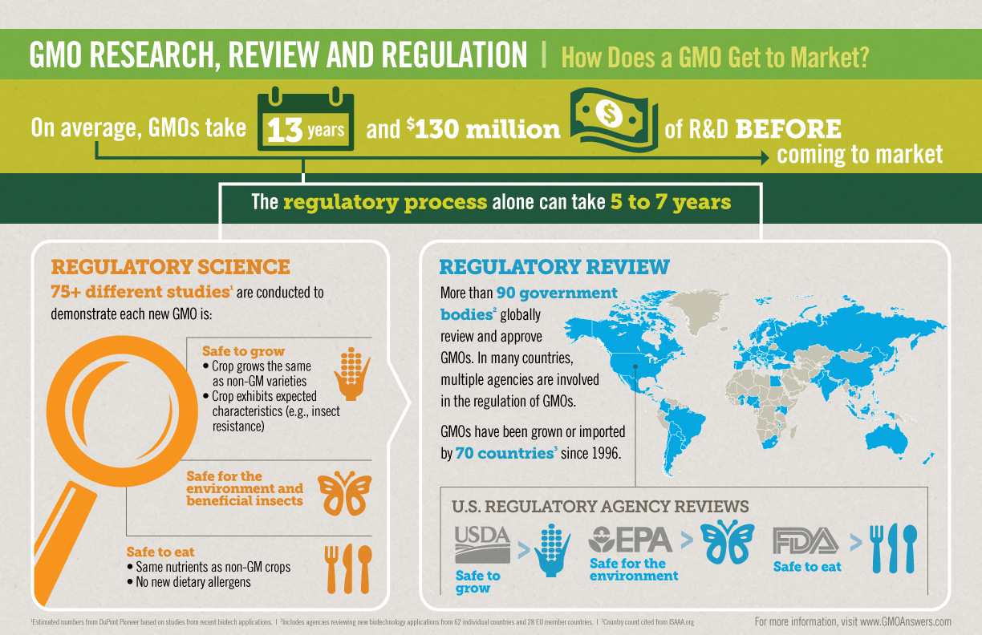
Safety of GM Foods
Source: GMOAnswers.com
Notes:
Plants and crops with GM traits have been tested more than any other crops—with no credible evidence of harm to humans or animals.
Independent scientists and the companies that develop biotech crops conduct tests for food, feed and environmental safety. Scientists at regulatory agencies review this data and are responsible for regulating the crops.
Independent scientists at regulatory agencies worldwide review the data for each potential product and make their own scientific assessment of its food, feed and environmental safety. There is broad global agreement among food scientists, toxicology experts and regulatory food safety officials on how to evaluate the safety of GM foods; and this strong regulatory framework has successfully ensured the safety of GM seeds.
Since 1996, when the first GM crops were widely commercialized (1996-2014), over 60 different countries have granted over 3,083 commercial use approvals on 357 different GM traits in 27 crops. The majority (1,458) of approvals on GM crops have been on the food safety of the product. (ISAAA Report)
Monsanto makes submissions to regulatory agencies in countries where we plan to sell our seed or where the crop is commonly imported. Regulatory agencies in each country must approve a potential product before it can be sold to farmers, or imported for food and/or animal feed in their country. In the United States, for example, the USDA, EPA and FDA share responsibility for overseeing and approving GM crops based on their specific areas of scientific expertise.

Slide 39
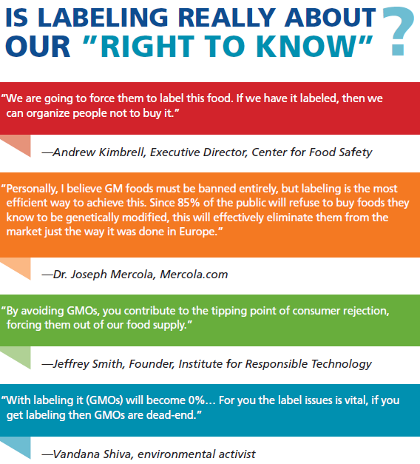
Source: http://esa.un.org/unpd/wpp/
Source: US Third National Climate Assessment (2013)
Source: UN FAO Food Balance Sheet, World Health Organization “Global and regional food consumption patterns and trends”
Source: The World Bank, Food and Agriculture Organization of the United Nations (FAO-STAT), Monsanto Internal Calculations
Source: ISAAA.org
Source: Croplife.org
Notes:
Quotes from activists that have publically indicated labeling reforms are to purposefully and negatively affect the biotech food industry

